Slide 1
AngularJS
The link() Function
Lecture 3
By James(Jin) Wang
08/08/2019

Slide 2
Outline
The link() Function
Building a TableHelper Directive
Requiring ngModel
Using $parse and $eval
Building a Google Maps Directive
Using $compile and $interpolate
Is link() Always Appropriate?

Slide 3
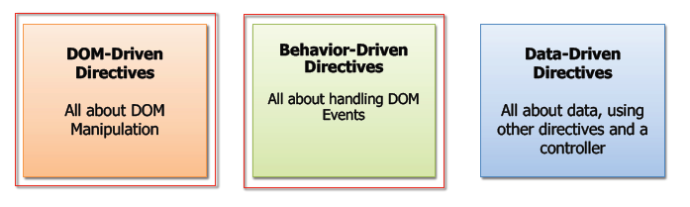
The link() Function

Slide 4
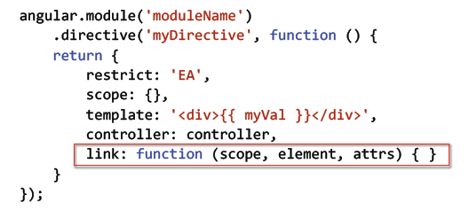
The link() Function
  The Link Function

Slide 5
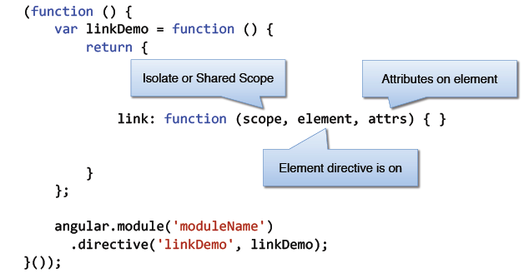
The link() Function
  Link Function Parameters

Slide 6
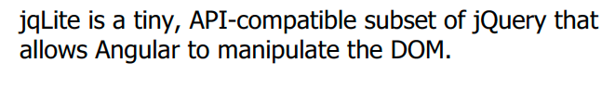
DOM Manipulation with jqLite

Slide 7
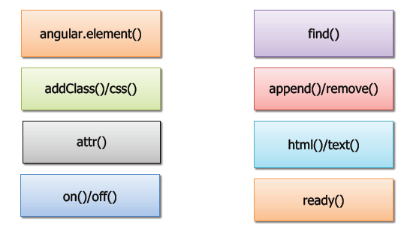
DOM Manipulation with jqLite
  Key jqLite Function

Slide 8
Building a TableHelper Directive
  Building a TableHelper Directive
  Demo:

Slide 9
Requiring ngModel
  Requiring ngModel
  Demo:

Slide 10
Using $parse and $eval
  Using $parse and $eval
  Demo:

Slide 11
Building a Google Maps Directive
  Building a Google Maps Directive
  Demo:

Slide 12
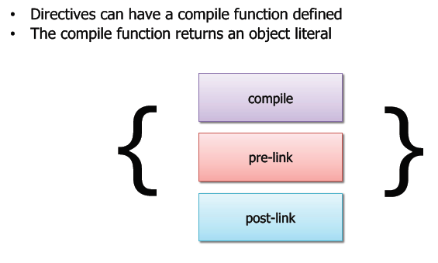
Using $compile and $interpolate
  The compile() function

Slide 13
Is link() Always Appropriate?
  Is link() Always Appropriate?
  Demo:

Slide 14
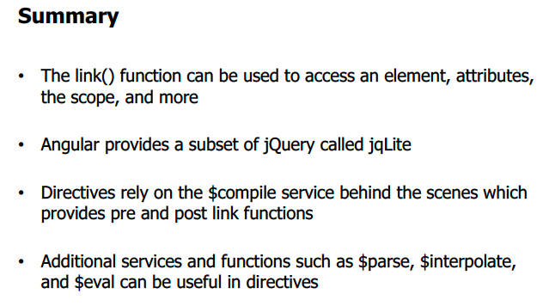
The link() Function

